Slide 1

Emporium South Region Analysis
By Lily Wells

Slide 2
What will I be analyzing?
In this report, I will analyze the following visualization prompts using Power BI:
The full period of sales trends covered by the data.
Sales performance by category.
Relative sales for each state in the region.
Top selling books (excluding textbooks) for my region.

Slide 3
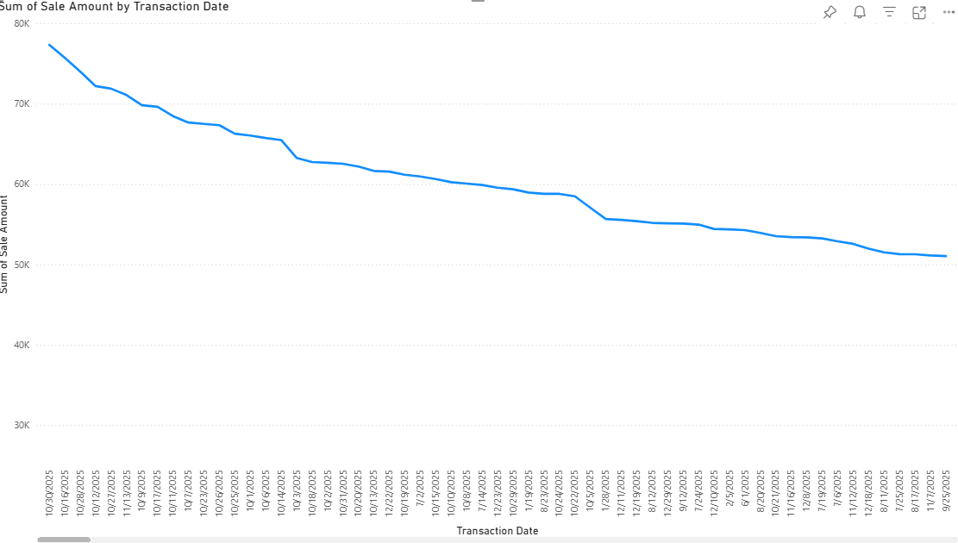
Sum of sales amount By transaction date
The highest point in our data takes place on October 30th, 2025.
The lowest point in our data takes place on March 23rd, 2022.

Slide 4
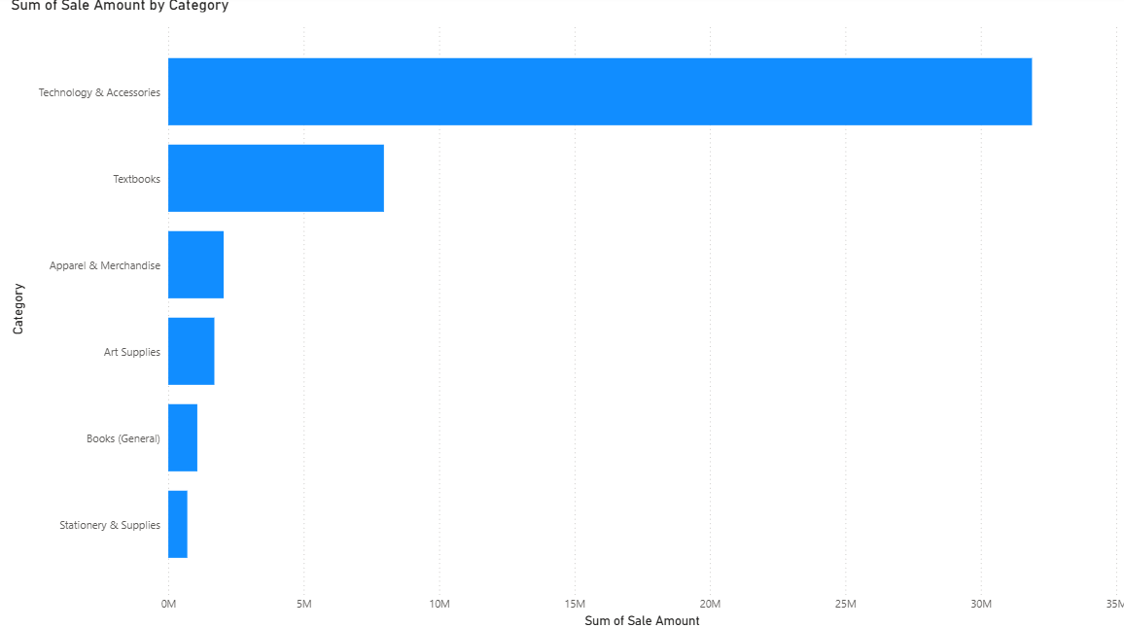
Sum of sale amount by category
The category with the highest sales amount is Technology and Accessories.
The category with the lowest sale amount is Stationery and Supplies.

Slide 5
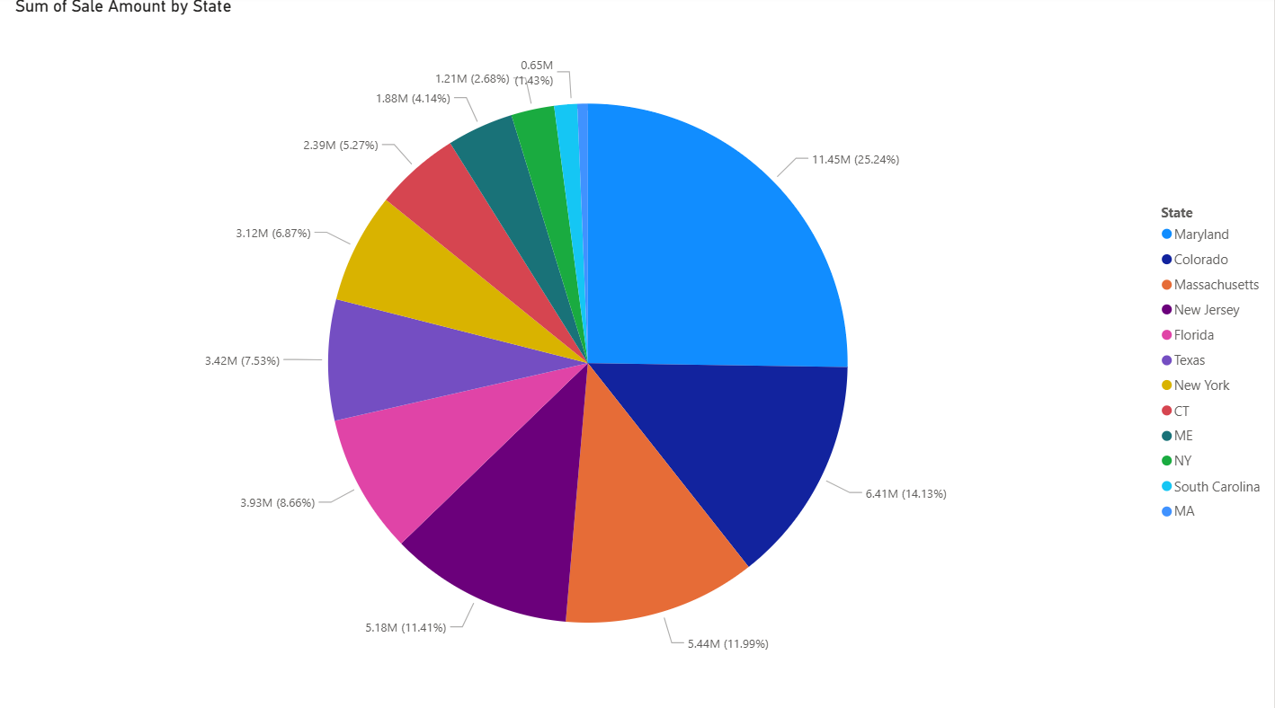
Sum of sale amount by state
The largest sale amount by state is Maryland with a total of 11.45M.
The smallest sale amount by state is Massachusetts with a total of 0.65M.

Slide 6
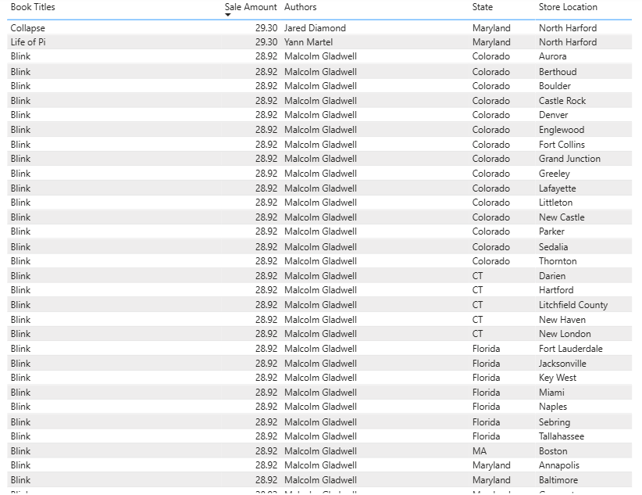
Top selling books (excluding textbooks)
Without taking textbooks into accountability and only measuring authored books (novels, chapter books, etc), the titles with the highest sales amounts are Collapse and Life of Pi with an amount of 29.30.
According to the data list, the lowest selling books are Born a Crime and Harry Potter and the Prisoner of Azkaban at a sale amount of 12.12.

Slide 7
My recommendation for the next quarter
I believe, based on the given data, we should focus our efforts on the highest performing book sales.
In order to keep our stores performing well, I believe we should take customer input and see what exactly makes certain books so popular to read – what genres and specific books does the public seem to enjoy? What is it about that genre that is so appealing? What could we do to make our selections more popular?

Slide 8

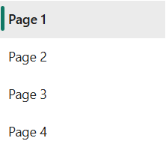
Power BI Service Report
https://app.powerbi.com/links/Z09W1JN7ct?ctid=bbce5c37-f181-4d0c-9310-7f877336e1cf&pbi_source=linkShare

Slide 9
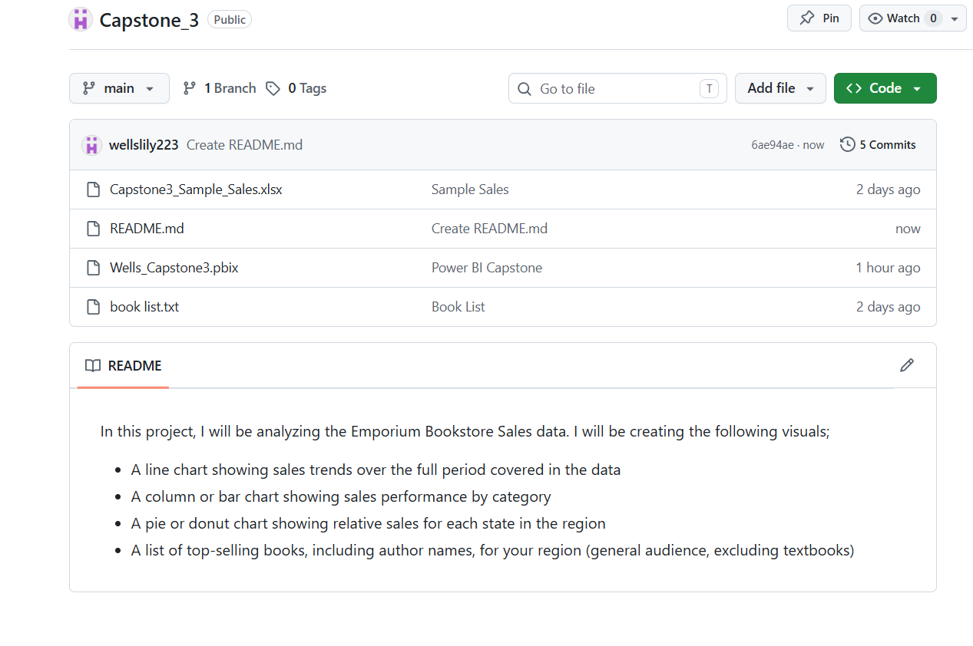
Github repository
https://github.com/wellslily223/Capstone_3
Please feel free to check it if you have any further questions!

Slide 10
Thank you!
I appreciate your time, patience and attention. Thank you for listening!

